Slide 1


Project Presentation
On
Minor Project- KrishnAI (Ancient Wisdom. Modern Guidance.)
Presented by :
Mr. Jayesh Borkar and Miss. Jividha Parwe
(MCA First Year, Semester II )
Department of Computer Applications
G H Raisoni Skill Tech University, Nagpur
Academic Session:2025-26

Slide 2
INDEX
Introduction & Problem Statement
Objective of Project
Existing vs Proposed System
System Architecture
Technologies Used
Implementation / Demo
Results & Conclusion
Future Scope
References (in IEEE format only)

Slide 3
Introduction & Problem Statement
Project overview: KrishnAI — a lightweight Flask web application that provides an interactive AI assistant (Krishna) for conversational support, daily shloka delivery with meaning/explanation, and a personal reflection journal; user accounts and conversation history are stored with SQLite.
Problem in existing system: At present the assistant handles single-turn queries and doesn’t retain context across follow-ups; adding session/context memory would enable deeper, continuous topic conversations.
Why this project is required: To offer students an accessible, focused assistant that blends AI conversation with daily shlokas and reflection tracking — improving motivation and self-reflection while being easy to deploy, demo, and extend for college projects.

Slide 4
Objective of Project
Provide contextual AI guidance: Deliver a culturally aware conversational assistant that gives calm, relevant responses tailored to spiritual and motivational queries.
Daily inspiration with explanation: Serve a short daily shloka plus clear meaning and practical takeaway to encourage regular reflection.
Private reflection journaling: Let users record and revisit personal reflections securely, preserving continuity of learning and growth.
Easy demoable & extensible platform: Keep the app lightweight and local‑deployable for college demos, with clear hooks for adding multi‑turn context, tests, and future features.

Slide 5
Existing vs Proposed System
Existing system drawbacks: The chat only answers one question and doesn’t remember earlier messages.
Proposed system solution: Save recent messages for each session so the assistant remembers the conversation.
Key improvements: Users can have longer, natural chats and get more helpful responses.

Slide 6
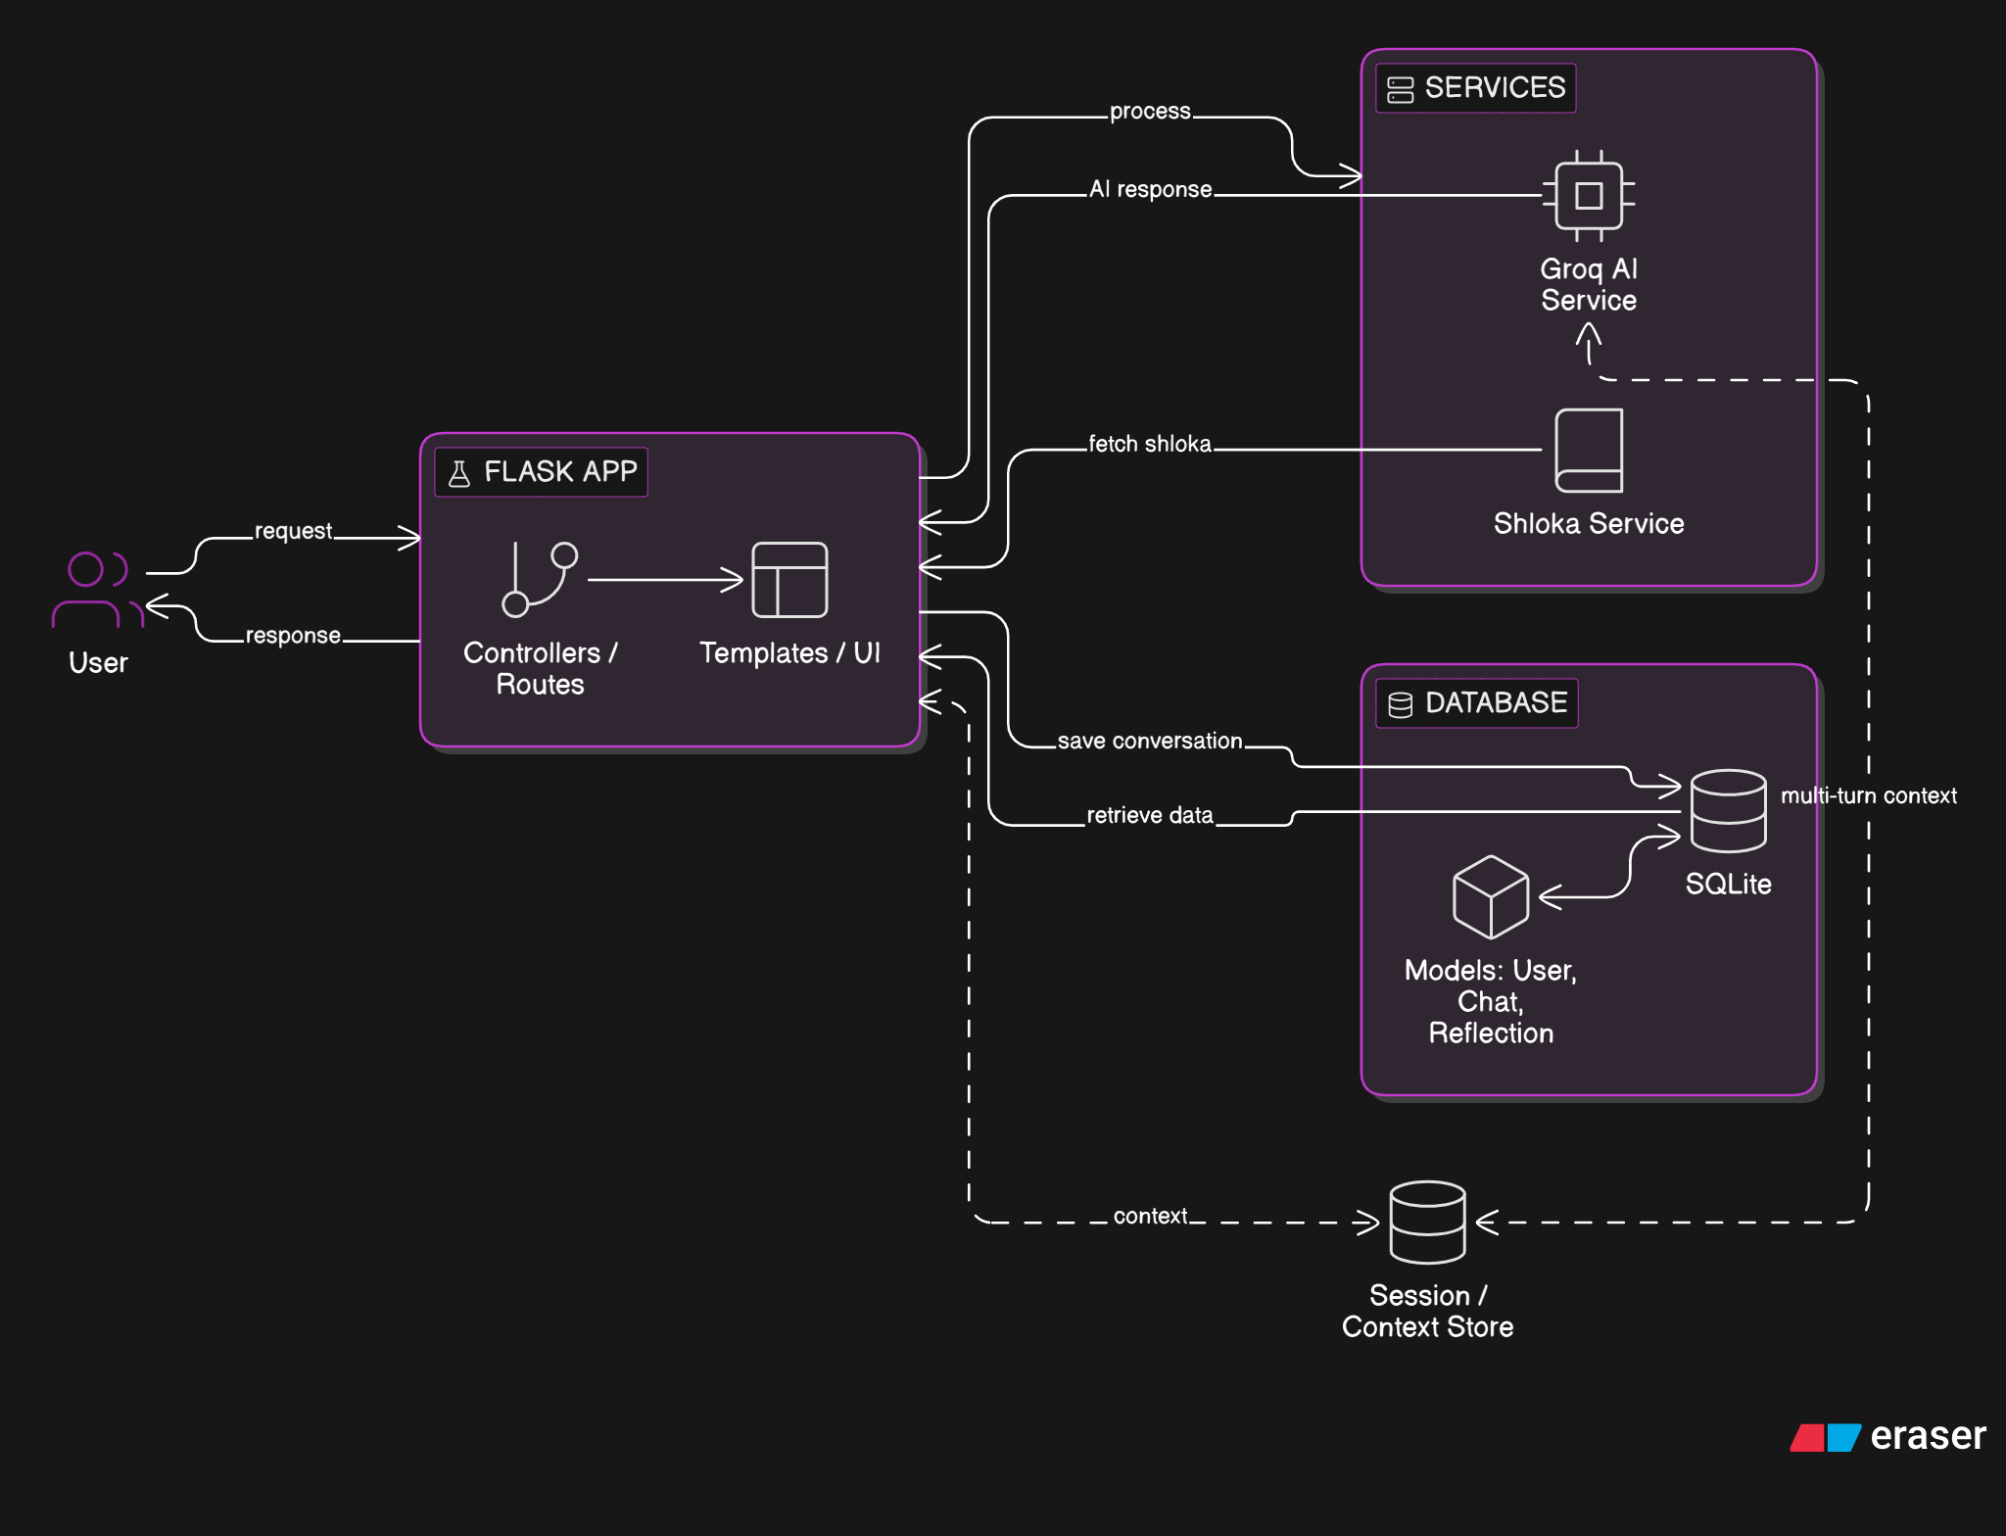
System Architecture
Architecture / block diagram:

Slide 7
System Architecture
Major modules:
Web app: app.py — routes and controllers.
Auth: Flask‑Login — signup/login and session protection.
AI service: groq_service.py— generates Krishna responses.
Content service: shloka_service.py — daily shloka + meaning.
Data & UI: models (SQLite) and templates+ static — storage and frontend.

Slide 8
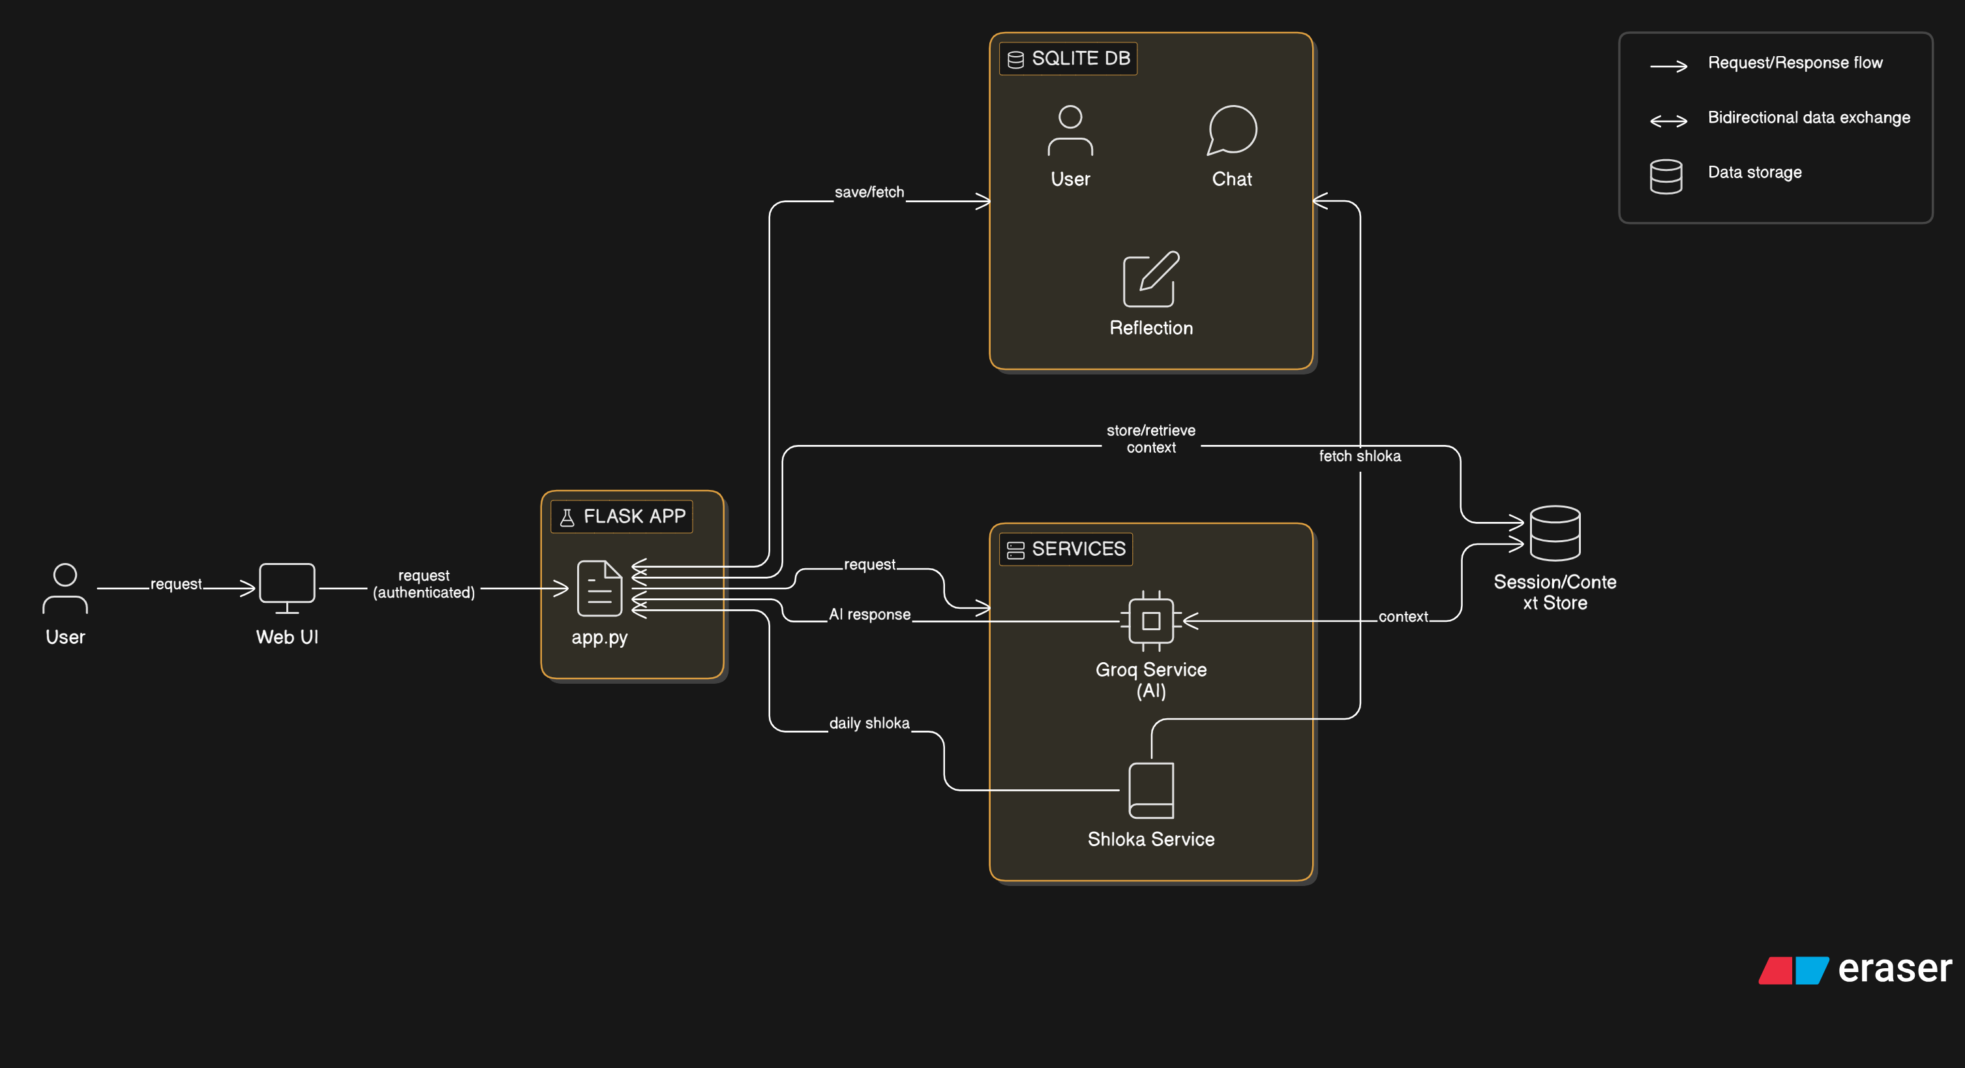
System Architecture
Data Flow:

Slide 9
Technologies Used
Frontend: HTML templates (templates), CSS (style.css) and simple JS (theme.js) using Jinja2.
Backend: Python with Flask (app.py) handling routes and controllers.
Database: SQLite via Flask-SQLAlchemy (models in models).
Tools / Frameworks: Flask-Login, groq (LLM client), python-dotenv, and developer tools (pip, virtualenv).

Slide 10
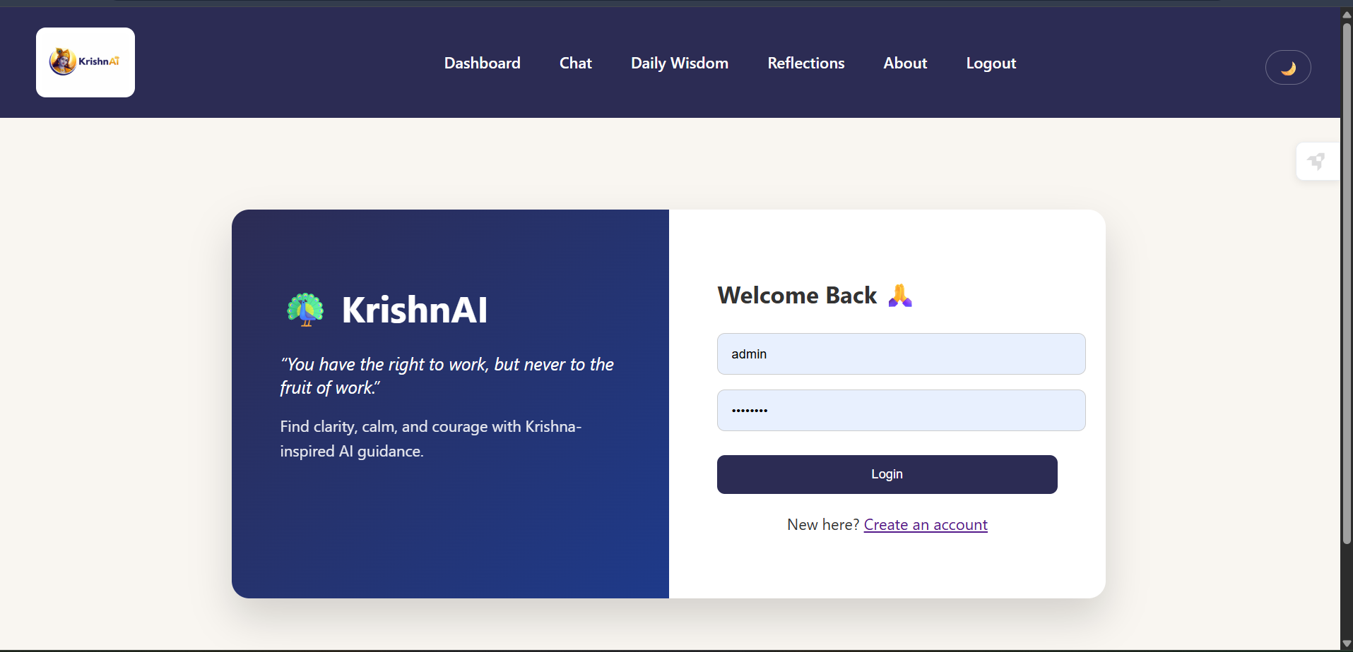
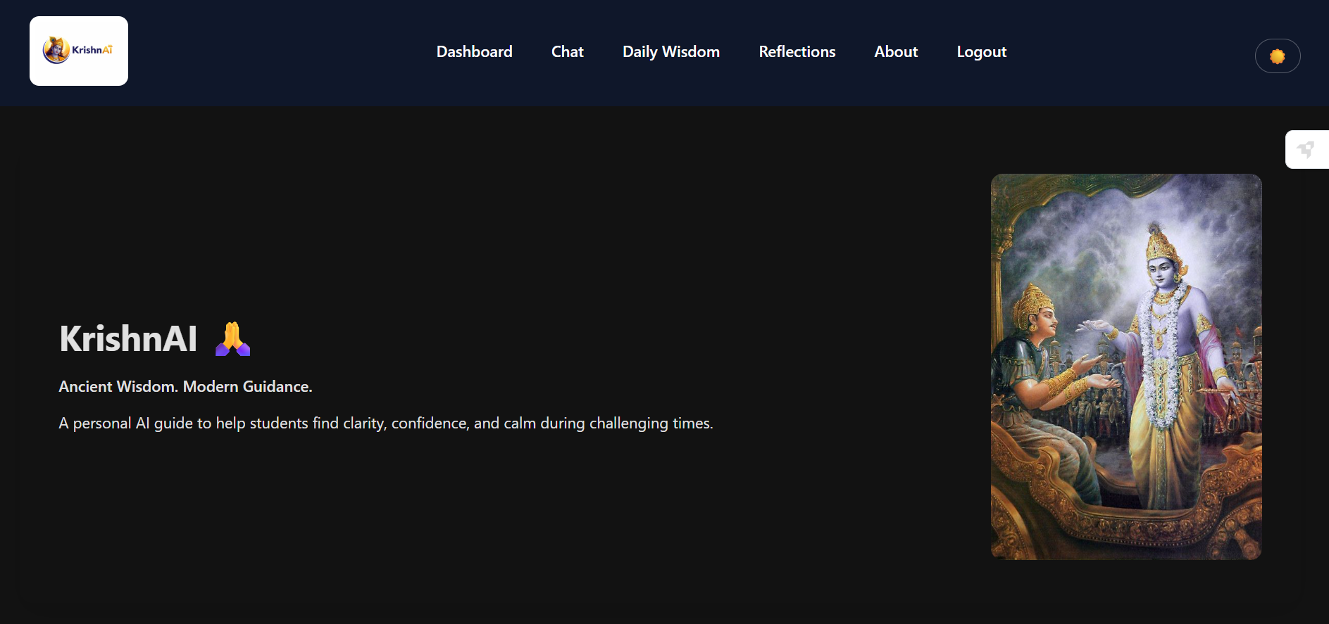
Implementation / Demo
Module-wise implementation
Screenshots / output:

Slide 11
Results & Conclusion
Results achieved: Functional Flask app with signup/login, AI chat (Krishna), daily shloka delivery, and saved reflections (SQLite).
Benefits: Students get quick spiritual guidance + private journaling; easy to run locally for demos.
Conclusion: Lightweight, demo-ready platform that’s extensible — next: add multi‑turn chat context and prepare deployment.

Slide 12
Future Scope
Enhancements:
Remembered conversations: add per‑user/session memory so the chat can continue topics across messages.
Scalability:
Better responses: upgrade to a stronger LLM model to get richer, more accurate replies.
Additional features:
Role selection: let users pick a spiritual guide role (e.g., Krishna, Guru, Mentor) so answers match the chosen perspective.

Slide 13
References
Books: Bhagavad Gita — translations/ commentaries (Eknath Easwaran; A.C. Bhaktivedanta Swami Prabhupada).
Research: Papers and articles on conversational agents, session/context memory, and AI‑guided tutoring (search for “dialogue context memory” and “conversational AI surveys”).
Websites: GitaGPT (project reference and inspiration).

Slide 14
Thank You! 🙏

